Slide 1



FlipFit
Notes:
Hi Everyone,
Good Morning
Before we start with the presentation today, I would like to share a small recital.
We have been a part of Publicis Sapient for almost 3months now, and there is this fact that everyone of us would agree upon.
We all started as fresh graduates, underwent 5weeks or so of rigorous training followed by what…5 weeks now of a Hands On project, and what has transpired in these days is a fact that we all are really proud of. A transformation from someone who could code, to someone who can not only code, but add value to everything he does.
So have we succeeded at becoming a Product engineer?
Hi, I am Rajat, a small part of our big team here.
I am here with my colleagues Aman and Chinmay and we are here to give you a walkthrough of our Transformation, our Journey and the project we have been working for sometime now.
1

Slide 2
Where did we start?
We began our journey as a team and we individually have only limited knowledge on smaller scope projects which we have done in our colleges.
On the first day, we only knew some fundamentals of Git, followed by the workings and syntax of Java.
2

Slide 3
6 days plan
Every Day Discussion about topics/technologies
Every day with SME/Trainer discussion of Project progress and tranformation based on UML and technologies
Framework for
the week
3

Slide 4
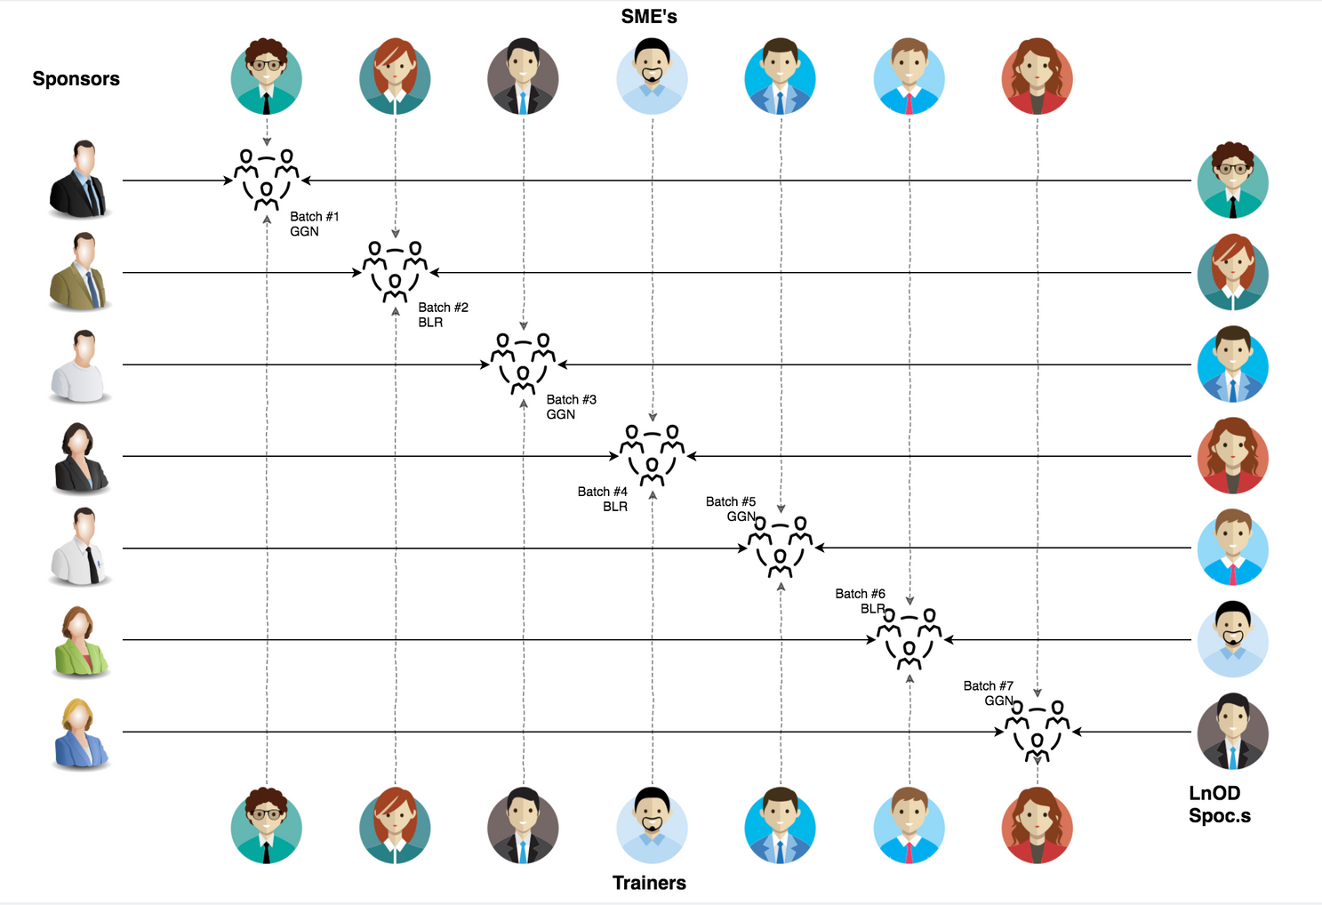
Stakeholders
Sponsors
1.1 Flipkart
2. SME’s
2.1 Mr. Amit Balyan
3. Trainers
3.1 Ms Anushka Khanna
4

Slide 5
Our next starts
NOW
5
Notes:
Time – 1 min
Swati
5

Slide 6
1 Week of Training + Project demo
6 DAYS
144 HOURS
8640 MINUTES
518400 SECONDS
Limitless knowledge
6
Notes:
6

Slide 7

Agenda
01
Our Journey
02
Our Team
03
Team Structure
04
Project Goals
05
Engineering Practices
06
Tech Stack
07
Development
08
Challenges & Learnings
09
Demo
10
Questions
7
7
Notes:
Time – 1 min
7

Slide 8
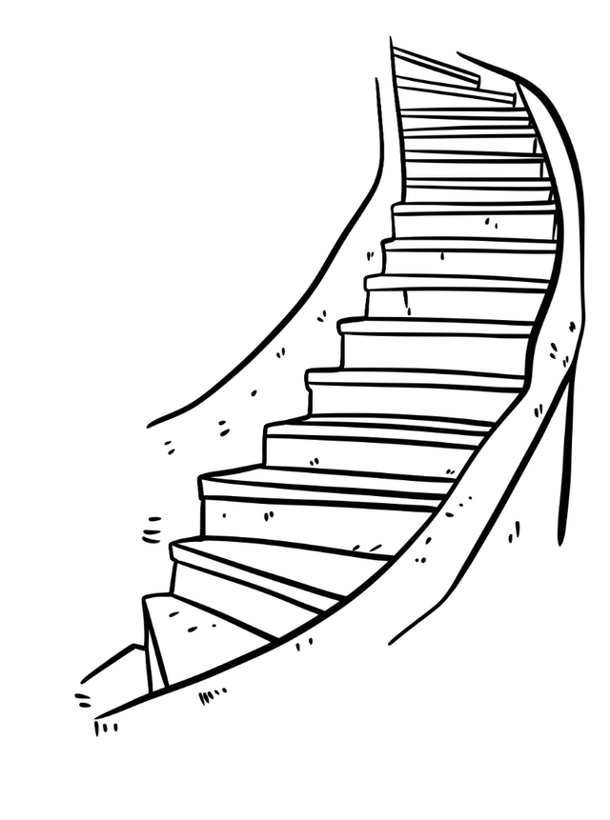




Our Journey
Project Demo
Adapting to a developer
Mindset
Design Thinking
Decide the Technologies JAVA, DropWizard, MySQL
Understanding Project Goals
8
8
Notes:
Time - 2 mins
8

Slide 9

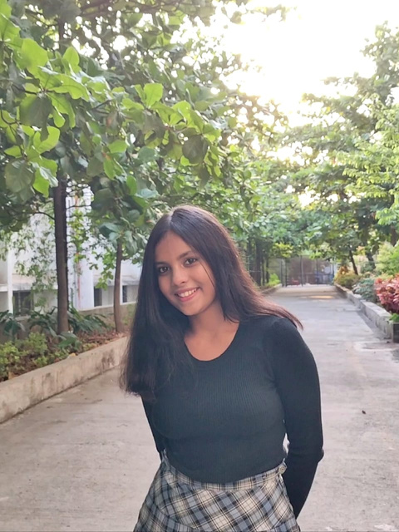
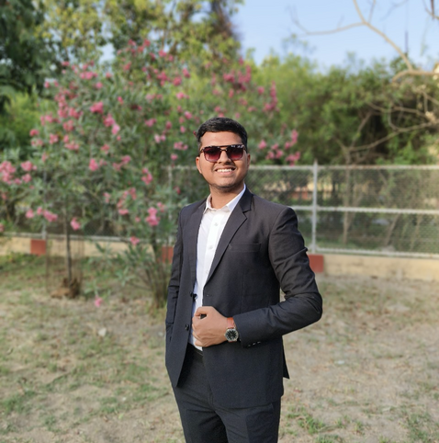
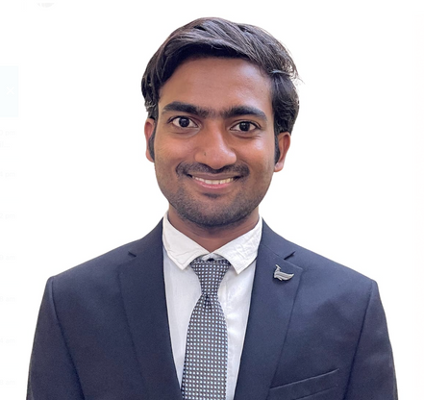

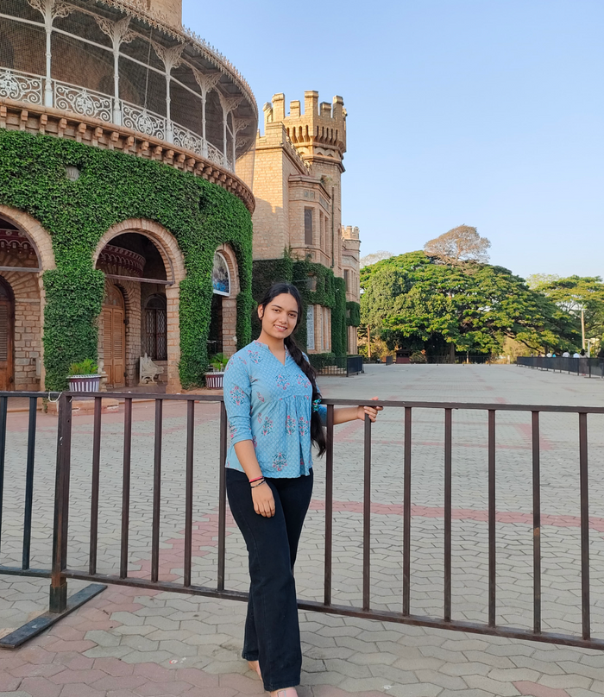
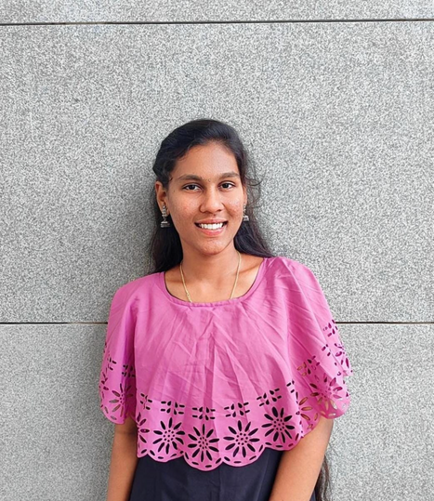
Our Team
Akanksha
Deependra Singh
Karan Kumar
Pragya Pandey
Isha Rawat
Dhana Sri
9

Slide 10
Team Structure
DropWizard Impl
Business Impl
Exception
Handling
DAO Impl
DAO Testing
10

Slide 11
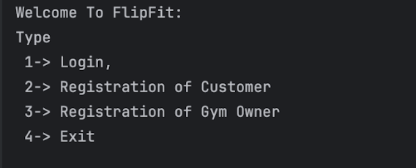

Project Goals
11
13
Notes:
Time – 3 mins
13

Slide 12
Problem Statement
Design FlipFit, an enterprise app for Flipkart's fitness venture in Bangalore. Features include multiple gym centers with fixed-hour slots per center, managed by admins. Users can register, view center availability, and book slots, ensuring no double bookings and capacity constraints. Simplified admin slot setup ensures accurate booking management.
12

Slide 13

Our Vision
FlipFit aims to revolutionize the fitness experience in Bangalore by addressing customer pain-points, offering a unified platform where users can easily discover, book, and manage gym slots across multiple centers.
13
Notes:
User satisfaction and brand value
14

Slide 14
Timeline for 1 Week
Day 1
Day 2
Day 3
Install necessary tools and establish team roles.
Discuss problem statement, goals, and solutions.a
Plan project milestones and deliverables.
Introduction to Git: Setup repository, branching, merging.
Low-Level Design (LLD): Use Case, Class, Activity diagrams.
Define application structure: Bean, Business, Client packages.
Explore JDK 17 features: Sealed classes, pattern matching.
Divide application into packages: Bean, Business, Client.
Start coding foundational components.
Day 4
Day 5
D day
Connect MySQL database to FlipFit App.
Implement DAO for database interaction.
Develop business logic and login functionality.
Evaluate Dropwizard or Spring Boot for scalability.
Setup project structure and initial configurations.
Begin web-based application development.
Conduct unit testing for modules.
Perform integration testing.
Prepare and documentati deployment procedures.
14

Slide 15

Engineering Practices
1. Version Control (Git/GitHub): Used Git for version control, feature branching, and regular commits.
- Benefits: Facilitates collaboration, tracks changes, and enables easy rollback.
2. UML Diagrams: Standardized on UML for system design, ensure clarity in diagrams, and use tools for consistency.
- Benefits: Aligns team understanding, supports documentation, and aids in communicating design.
3. Design Principles (SOLID): Applied SOLID principles (Single Responsibility, Open/Closed, Liskov Substitution, Interface Segregation, Dependency Inversion) for robust, maintainable code.
- Benefits: Improves code quality, scalability, and facilitates easier maintenance and extension.
15
15
Notes:
Time – 5 mins
15

Slide 16

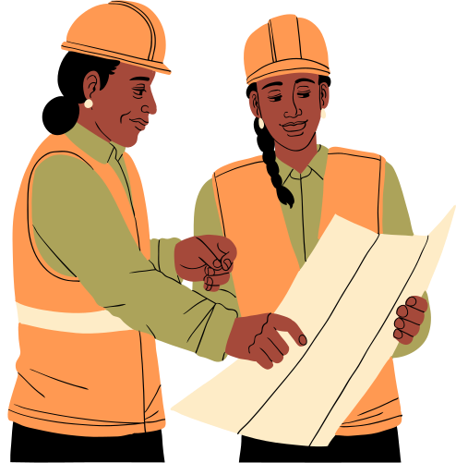

4. Business Modules and Packaging: Organized code into cohesive modules aligned with business domains, use appropriate packaging structures.
- Benefits: Enhances modularity, reduces dependencies, and improves code organization and reusability.
5. Documentation and Knowledge Sharing: Maintained comprehensive documentation and Conducted internal team meetings before working on any feature
- Benefits: promotes knowledge sharing, and serves as a reference for future development and maintenance.
16
Notes:
Product Thinking (Design Thinking, Requirement Analysis, )
Multi Skilled (Frontend, Backend, DevOps)
Fast Decision Making (Agile)
Increasing the Pace (Automation CI/CD)
Startup Mindset (Agile)
Continuous Improvement (Retros)

Slide 17
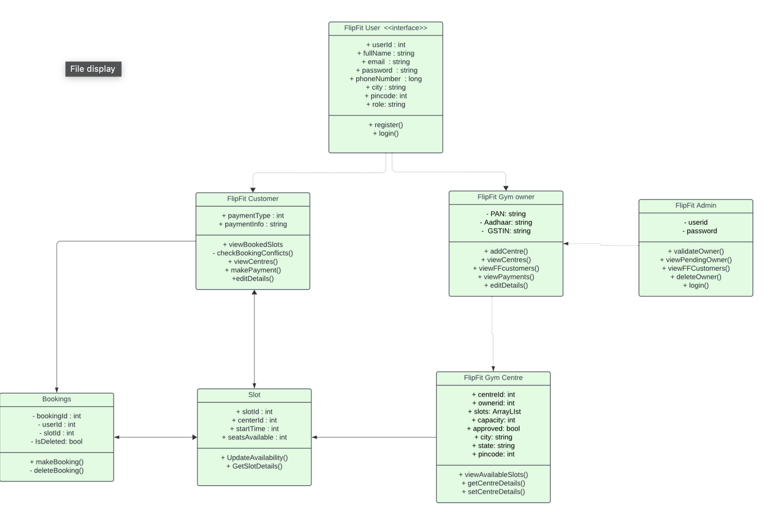
UML
Diagrams
We planned our code structure at the start so features can be vertically implemented, preventing a waterfall model.
For this, a predesigned Schema and class diagram were important and the first steps of our bottom-up development.
17

Slide 18






TechStack
Backend
Data
Tools
18
18
Notes:
Time – 1 min
18

Slide 19

Development
Define sprint goals
prioritize user stories, estimate time and resources
Requirement understanding
Research and analysis
Estimation
Sprint Planning
Spring Grooming
Delivery
Sprint Implementation
Integrate
Deploy
Test
LLD
Development
Code Review
Commit
19
19
Notes:
Time – 1 min
19

Slide 20

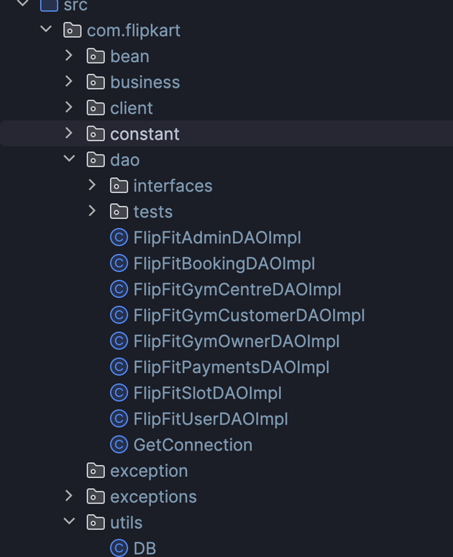
Project Structure
How did we write code?
Bottom-up code written
Vertical responsibilities
21

Slide 21
What we did well
Full CRUD functionality in User, GymOwner, GymCustomer, Bookings, Slots and GymCentre DAO’s
Backend functionality for multiple payment types for the customer
Well tested and functional backend
Minimal merge conflicts, proper branching of project
Extensively used git
25

Slide 22

Challenges
&
Learnings
21
22
Notes:
Time – 2 mins
21

Slide 23
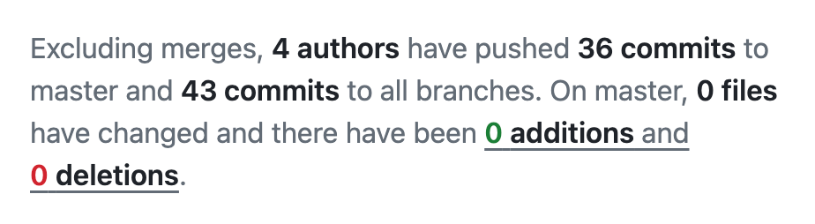
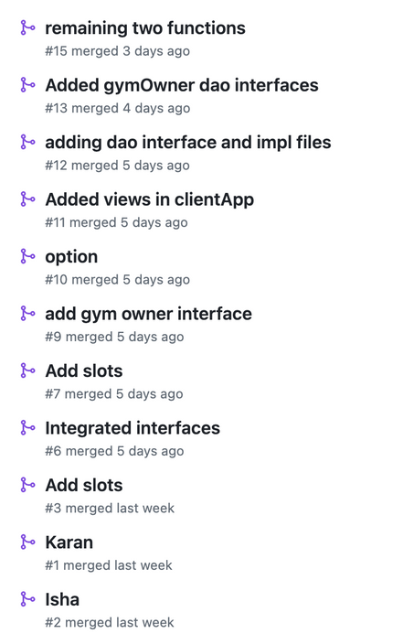
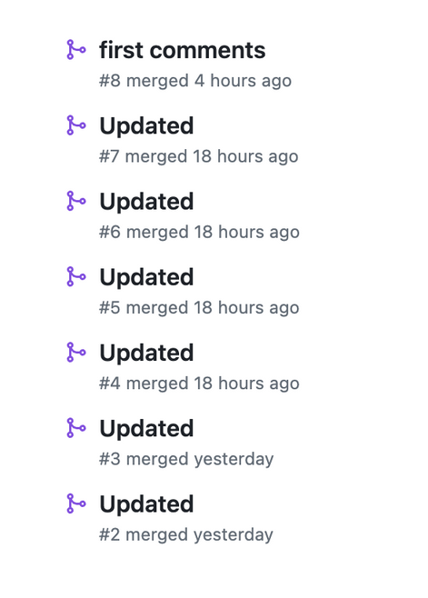
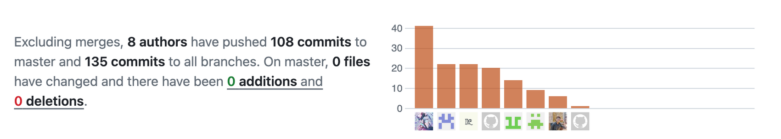
GIT & GITHUB
Challenges: Handling merge conflicts, coordinating parallel work, and ensuring version control consistency.
Learning: Improved collaboration skills, conflict resolution techniques, and understanding of branching strategies for efficient team workflows.
23

Slide 24
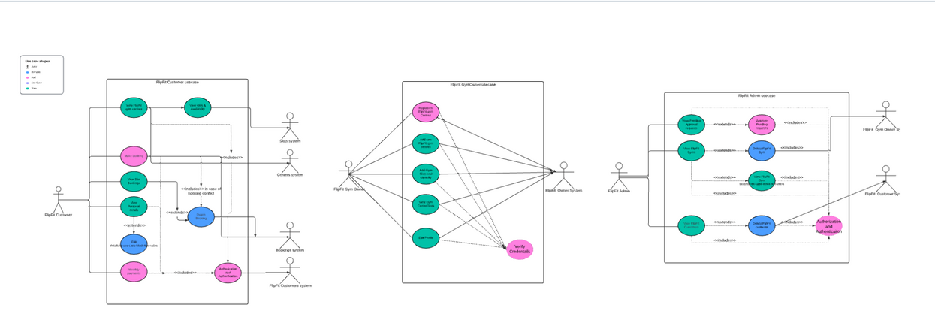
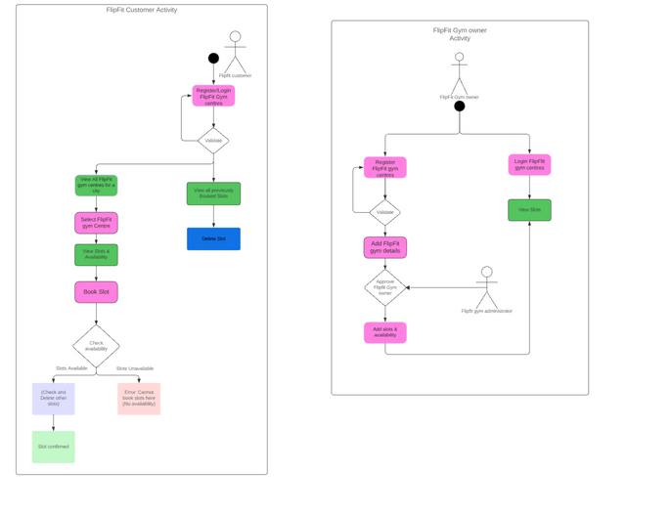
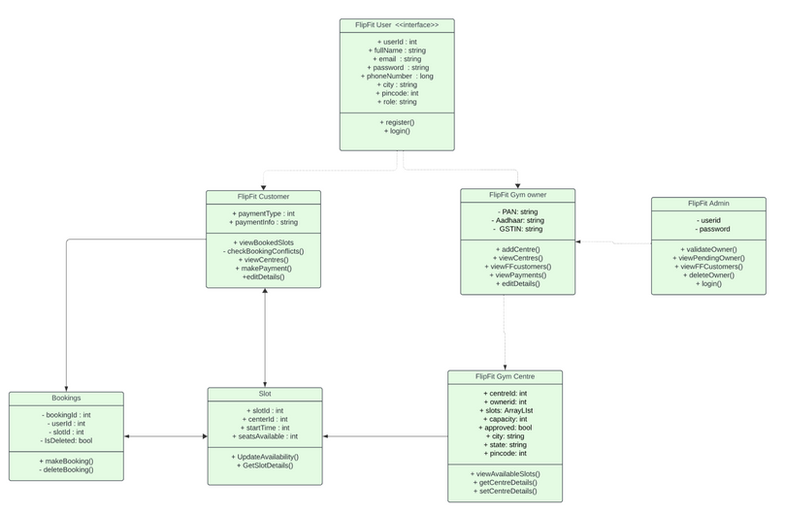
UML Diagram - LLD Structure
Challenges: Collaborating in a diverse team of six with varying educational backgrounds, aligning on a single process flow and holistic system view.
Learning: Enhanced understanding of software design principles, standard notation usage, and aligning diagrams with business module requirements for clearer communication and design documentation.
24

Slide 25

Demo
26
Notes:
Time –
Architecture – 5 mins
NFR Dashboard – 3 mins
Demo – 10 mins
1. Show the Responsiveness and Wave tool first
22

Slide 26

Questions
23
27
Notes:
Time - ?
23

Slide 27
Thank you!
28
Notes:
Time – After this show the testimonial video. 1 min
24

